Slide 1
Milestone 4: Conclusion
Michael Surdek
Southern New Hampshire University

Slide 2
Predicting e-Reader Adoption via Decision Tree Modeling

Slide 3

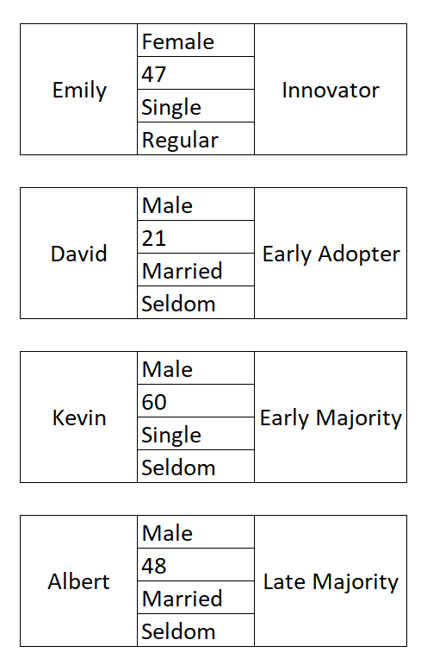

Customer Classification
Notes:
These are 4 examples of customers that might fit into each of the 4 adoption categories. The information listed is basic information about each of them which was used along with other information to make the classifications.

Slide 4
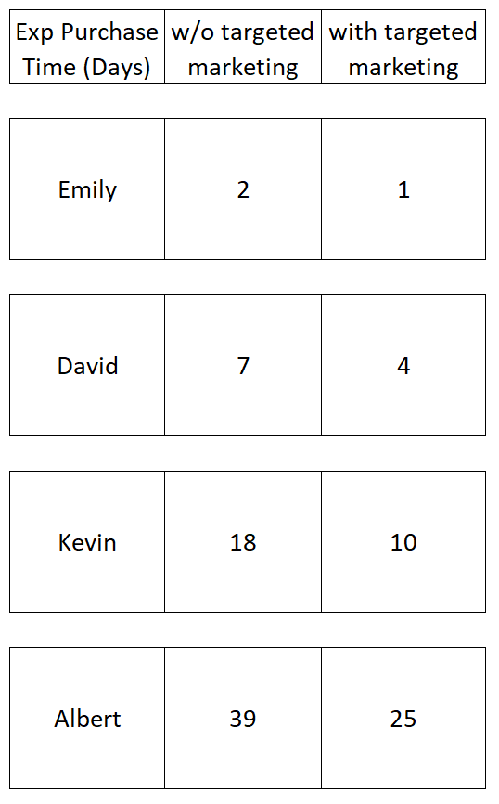
Targeted Marketing Effects
Notes:
We were able to use past data to predict when each of the 4 customers would be most likely to purchase our e-Reader if we rolled it out like normal and did not apply any targeted marketing efforts. Using research on marketing campaigns, we were also able to predict when each of the 4 customers would be most likely to purchase the e-Reader if we roll it out and target marketing towards each individual when they would be most likely to respond positively. For example, David is an early adopter who would normally wait a week before purchasing the e-Reader. He likes to make sure customer reviews show the product is as expected and delivers on its promises. With targeted marketing such as a sale over the first few days on the marketing, David is more likely to purchase the e-Reader after just a few days. He would not pre-order the e-Reader like an innovator would, but he would still be willing to commit for a discount once he sees actual customer reviews.

Slide 5

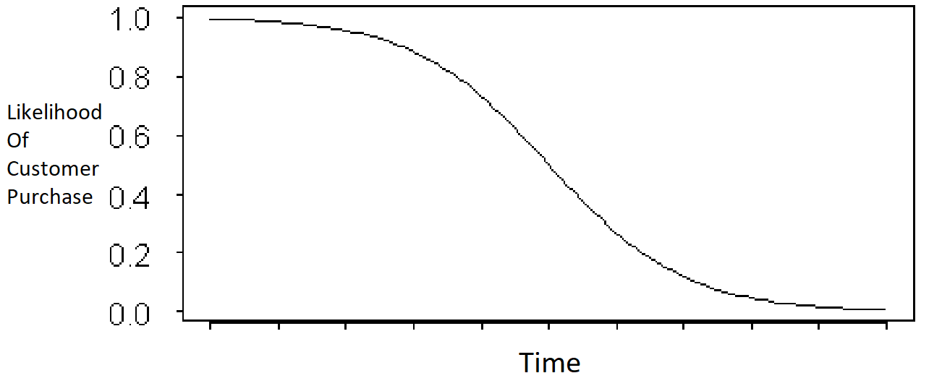
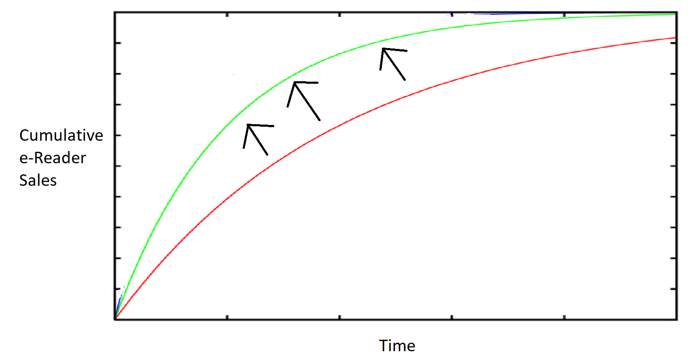
Value
Increase overall sales by lessening the negative impact of time on the likelihood a customer will purchase
Notes:
The main value of this initiative which makes customers purchase earlier than usual is that it will increase overall sales by lessening the negative impact of time on the likelihood a customer will purchase. When a product is introduced, you can map the likelihood that any individual customer will eventually make the purchase. Since all future days are incorporated into the overall likelihood, as time goes on and days pass, the likelihood only decreases. By convincing customers to commit to purchases earlier, more e-Readers will be sold in total.

Slide 6
Insights
Benefits
How many potential customers do we typically lose with each passing day?
Customers purchasing earlier has more benefits than just increasing overall sales
Increased customer lifetime value
Revenue from services & other products
Referrals
Satisfied customers tell their friends
Trends and insights can be used for future product releases and additional data analytics initiatives
Notes:
This data analytics initiative will have a multitude of benefits for our organization. The first, as mentioned above, is increasing total sales. The best question to ask yourself is how many potential customers do we typically lose with each passing day? Many of these customers are lost simply because time passes, and our product is no longer on their mind like it was before. When you look at it this way, this initiative has clear value. Additionally, customers making earlier purchases has benefits beyond just increasing overall sales. Customers who purchase earlier will have a larger customer lifetime value (CLV). This is because they are more likely to purchase our future e-Readers, and also because we will gain more revenue from the more time they use our other products and services. Another benefit is referrals. Customers who make earlier purchases will get the most out of their products and be more satisfied with the product and our organization. This leads to word of mouth referrals, which is possibly the most effective marketing strategy that exists. Finally, this data analytics initiative will create insights and show trends that can be applied to future product releases and more extensive projects.

Slide 7
References
Beck, Martin. ‘Can You Predict If a Customer Will Make a Purchase on a Website?’ (2019) towardsdatascience.com
EMC Corporation (2012) Module 3 - Data Analytics Lifecycle. snhu-media.snhu.edu.
North, Matthew. ‘Data Mining for the Masses.’ (2012.) A Global Text Project Book.
Siriwardhana, Chathuranga. ‘Decision Trees for Online Shopping Analysis.’ (2019.) towardsdatascience.com.

